Slide 1

Phishing Awareness Training
Subject - Recognize, Resist, Avoid, Social Engineering Tactics and Reporting phishing Emails & Websites,
Presentation by Emmanuel Agwamba
Under guidance of CodeAlpha

Slide 2
What is Phishing?
Phishing can be explained as a fraudulent that is designed to trick people into revealing credentials, sensitive data or money.
It could be carried out via email, SMS, phone calls, fake websites, or social media.
The goal is to gain unauthorized access, steal funds, or deploy malware.

Slide 3
TYPICAL ATTACK FLOW
Phishing commonly occurs through:
Attacker crafts a believable lure (email, sms)
Lure contains a link or attachment
Victim clicks or calls and reveals sensitive credentials or grants access to attackers.
Attacker uses access to steal sensitive data or money.

Slide 4
Types of Phishing Attacks
Spear phishing – This is a targeted cyberattack where an attacker impersonates a trusted source to trick an individual or organization into divulging sensitive information or downloading malware. This technique is, by far, the most successful on the internet today, accounting for 91% of attacks.
Clone phishing – This type of phishing attack copies a legitimate email and modifies it with malicious links or attachments to trick the recipient. This is either done by creating a near identical replica or by hijacking the legitimate emailto get the original message.

Slide 5
Types of Phishing Attacks
Voice Phishing - Sometimes referred to as 'vishing’, and is a fraudulent practice where scammers use phone calls to trick people into giving up sensitive or financial information including passwords, bank account details and credit card numbers.
Mass Phishing – This is the indiscriminate sending of fake emails to a large number of recipients in an attempt to trick a percentage of them into revealing sensitive information like login credentials or financial details.

Slide 6
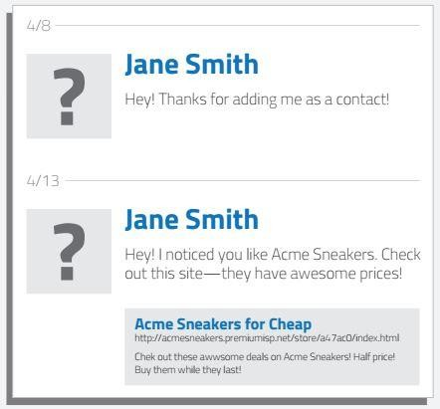
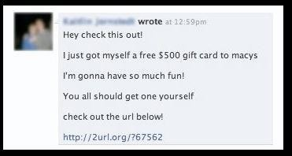
Examples of Phishing Attacks
Social Engineering
1
The one on the right is a common example of a mass phishing attack through social media. Upon clicking the link, it would prompt you to log in again, but this time to a fake Facebook page, and steal your log in information and take over your profile sending out the same or another mass phishing attack to your friends and contacts.

Slide 7
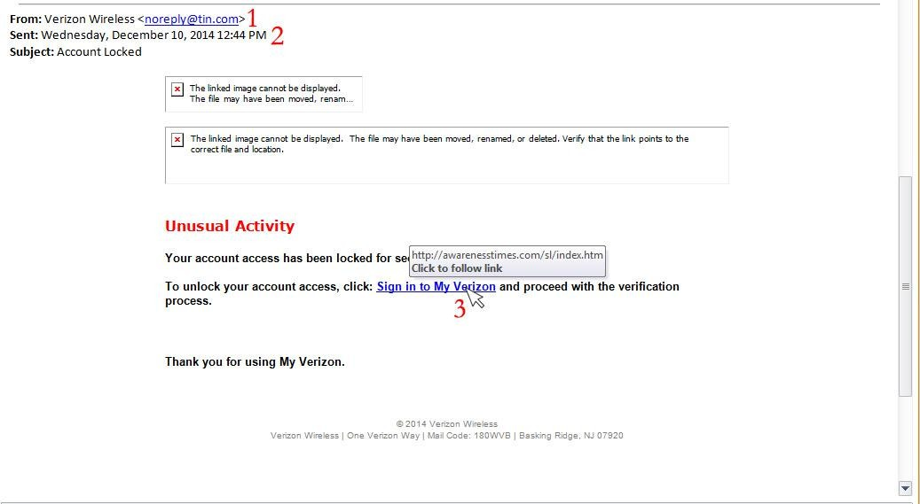
Examples of Phishing Attacks
Link manipulation
Although this looks completely legit, seeing the name “Verizon Wireless”, if you look at the actual email, it is an @tin.com address rather than a @verizon.com address.
The To: line is missing, indicating that this is a mass email that they want to avoid you seeing.
And Hovering your mouse over the link, you can see that this does not take you to a Verizon website, but rather to a random website which would more than likely exploit your login information and take over your account.

Slide 8
Tips to protect yourself from Phishing emails.
SOCIAL ENGINEERING TRICKS
Attackers research your jobs, hobbies, and contacts online, then use these personal info to sound trustworthy and urgent
Example: “ your manager requested this invoice be paid immediately ”
Good Practice – Always verify unexpected requests, even from known contacts

Slide 9
Tips to protect yourself from Phishing emails.
SPOTTING FAKE LINKS
Hover over links before clicking – Check for strange domains
Look out for misspellings (e.g., micorsoft.com instead of Microsoft.com)
Avoid shortened URLs unless verified.

Slide 10
Tips to protect yourself from Phishing emails.
SPOTTING PHISHING EMAILS
Be cautious about opening attachments and downloading files from emails, regardless of who sent them. These files can contain viruses or other malware that can weaken your computer's security.
Never enter private or personal information into a popup window.
I.T. will NEVER ask for your password over email. Please be wary of any emails asking for passwords. Never send passwords, bank account numbers, or other private information in an email.

Slide 11
Tips to protect yourself from Phishing emails.
SPOTTING PHISHING CALLS
There’s always a sense of urgency e.g., “You have to make up your mind right away”.
Resist pressure to make a decision immediately and never share codes or account numbers over calls
Don’t take calls from unfamiliar & impatient companies. Legitimate businesses understand that you want more information about their company and are happy to comply.
If you have been victimized once, be wary of persons who call offering to help you recover your losses for a fee paid in advance.

Slide 12
AFTER SUSPECTING PHISHING.
Don’t click or reply.
Report to IT/Security.
Block the sender and delete the message.
For calls, report suspicious numbers to your service provider.
If you clicked a link, change your passwords immediately.
Scan your system for malware.

Slide 13
CONCLUSION
Remember Phishing = Fake urgency + Emotional pressure + Click trap
Always think before you click or respond
Report suspicious emails or calls immediately
Remember tips for evading phishing of whatever type (Note - These tips are inter-related and so apply depending on the situation)

